Slide 1
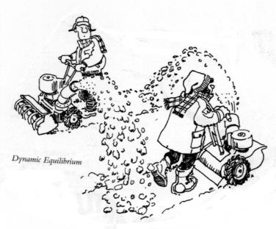
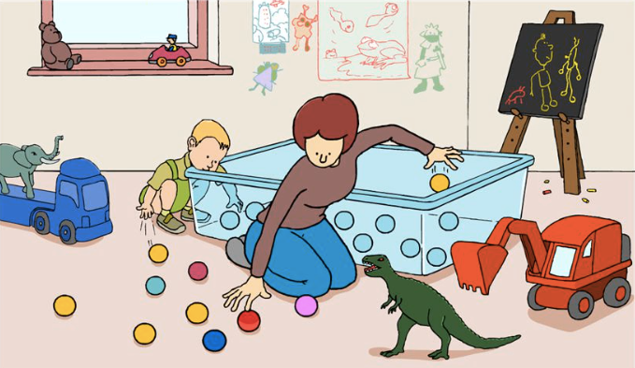
Factors affecting equilibrium
Concentration
ATAR Chemistry Unit 3 2021

Slide 2

Outline
Review some key points
Affect of changing concentration has on an equilibrium
Le Châtelier's prediction
Collision theory
Graphs

Slide 3
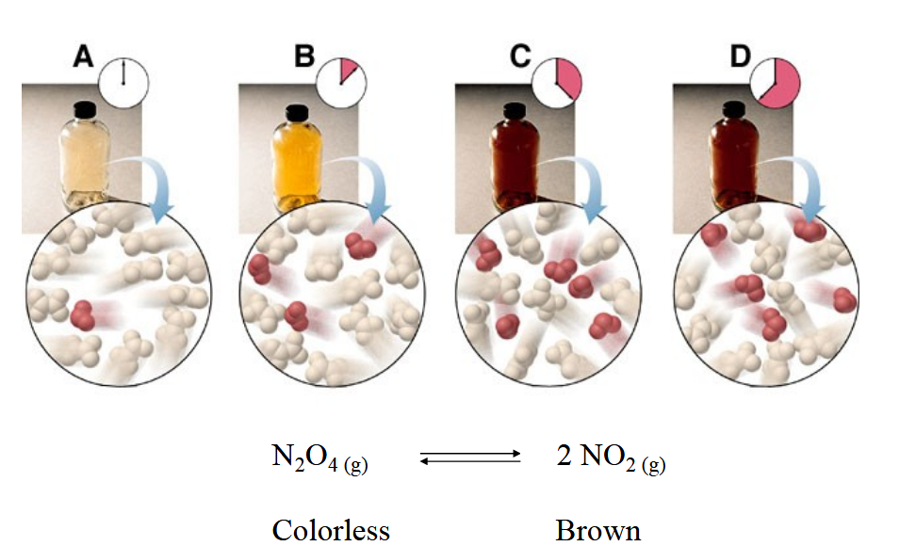
Review
Reaching equilibrium on a molecular and macroscopic level (starting with dinitrogen tetroxide)

Slide 4
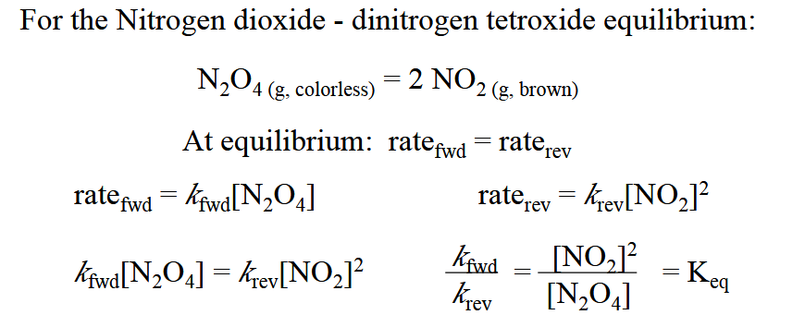
Review
Deriving the equilibrium constant expression:

Slide 5
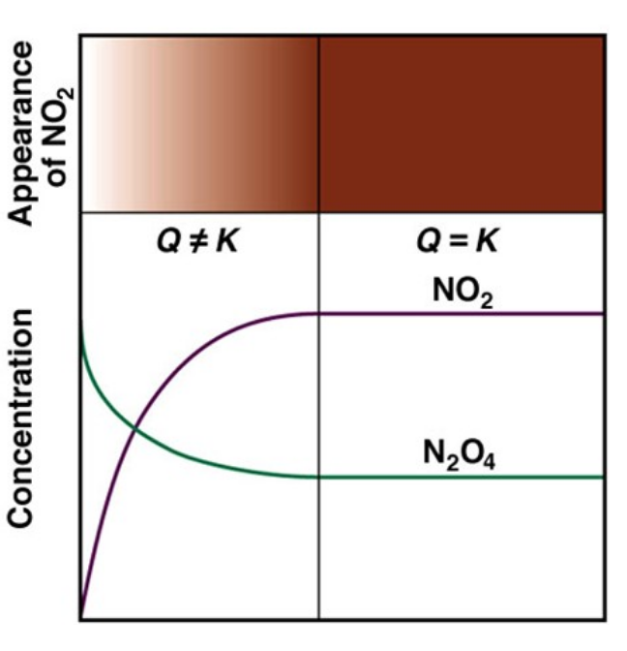
Review
Q is the reaction quotient when the reaction is not at equilibrium
See the macroscopic property (in this case colour) is only constant once Q = K. Before that it is a changing gradient of colour

Slide 6
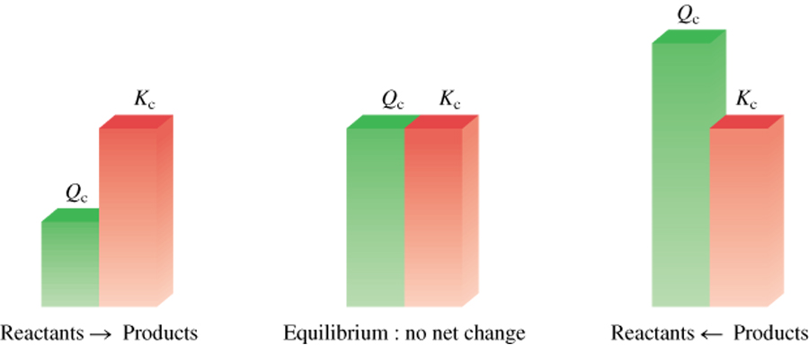
Review
Q > K system proceeds from right to left to reach equilibrium
Q = K the system is at equilibrium
Q < K system proceeds from left to right to reach equilibrium

Slide 7
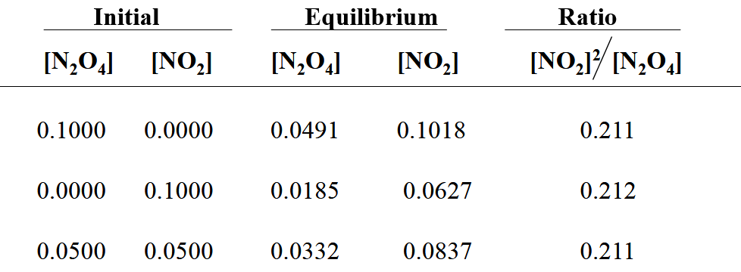
Review
It doesn’t matter how you start, when you have a closed system that reaches equilibrium the Kc value will be the same

Slide 8
Concentration
Effect of changing Reactant or Product Concentrations
Adding a reactant or product shifts the equilibrium away from the increase.
Removing a reactant or product shifts the equilibrium towards the decrease.
N₂(g) + 3H₂(g) ⇄ 2NH₃ (g)
concentration
Add in more NH₃(g) – to counter the imposed change, favour reverse reaction. Therefore the [N₂(g)] increases and concentration of [H₂(g)] increase
Consider the stoichiometry – if I add more ammonia, nitrogen will increase by factor of one but hydrogen will increase by a factor of three

Slide 9
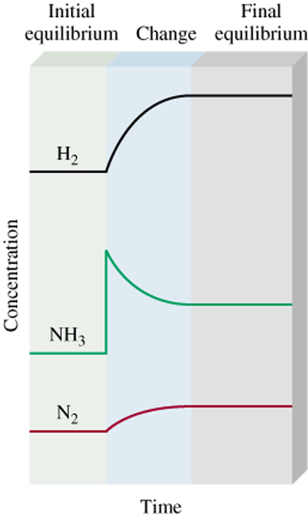
N₂(g) + 3H₂(g) ⇄ 2NH₃ (g)
Collision theory
Add more ammonia, system is open and not at equilibrium (matter entering)
[NH₃(g)] increase, more particles of ammonia in the space, so increase the frequency of collision between ammonia particles leading to increase in rate of the reverse reaction.
Causes [NH₃(g)] to decrease while [N₃(g)] and [H₂(g)] increases. The increase in reactant concentration means the forward reaction also increases and eventually equalises with the reverse reaction again

Slide 10
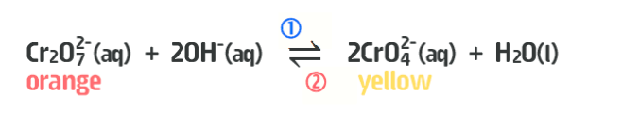
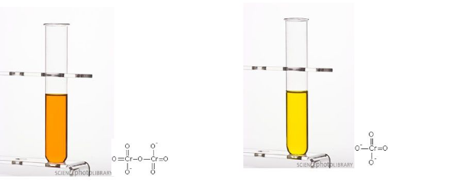
Concentration

Slide 11
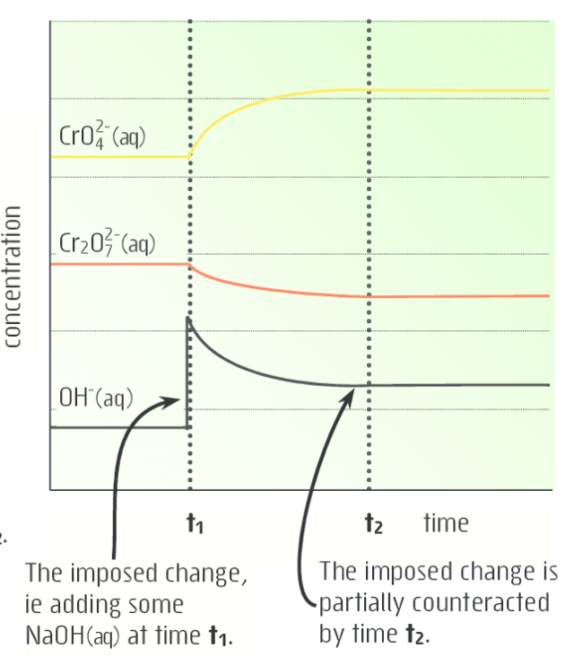
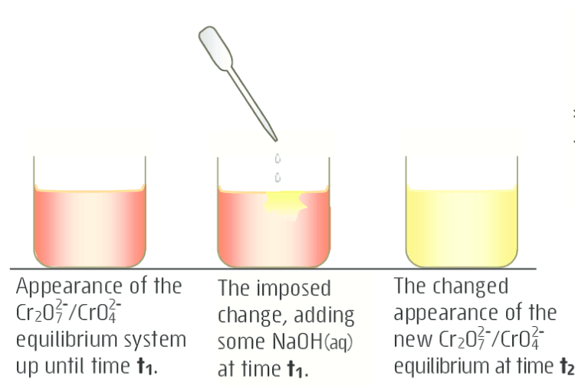
Concentration

Slide 12
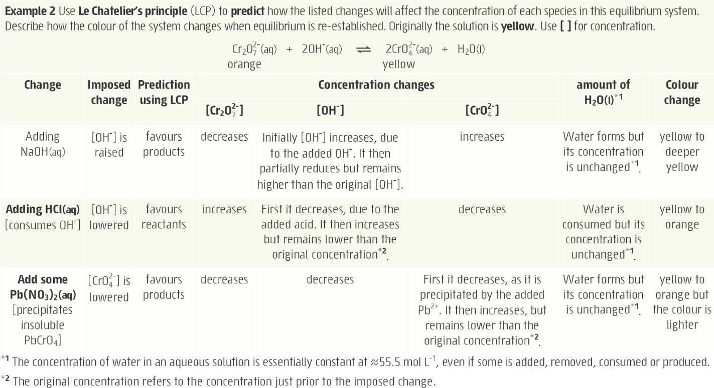

Slide 13
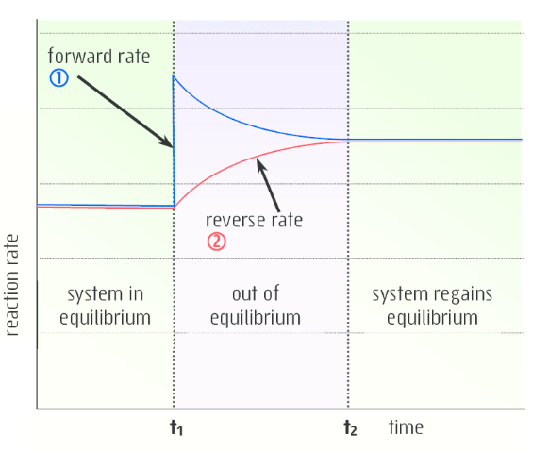
Concentration

Slide 14
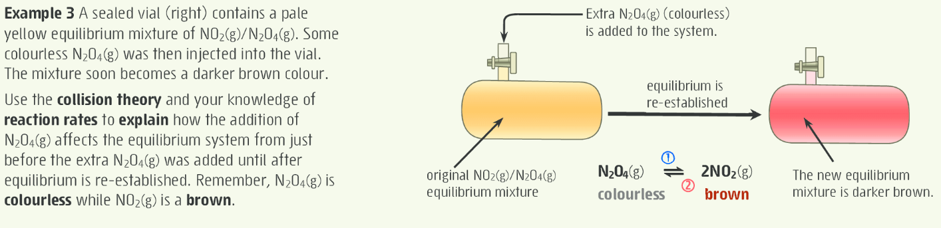
Concentration

Slide 15
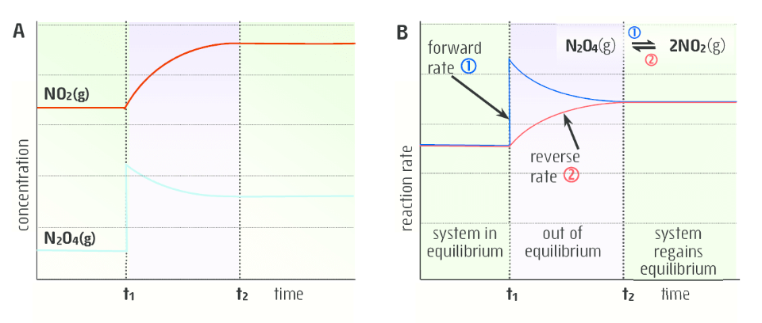
Concentration

Slide 16
On going work
Essential chemistry, Set 2 Q1 – 11
STAWA Set 6

